Slide 1
Anxiety Disorders;
Obsessive-Compulsive and Related Disorders;
Trauma and Stressor-Related Disorders
F. Muvea

Slide 2
What is anxiety?
Anxiety is a normal emotion which helps us recognize real problems and solve them.
In its healthy form, anxiety helps you perform at your top form when you’re adjusting to, say, a new task or a new situation
Anxiety is not normal when it lasts days beyond a specific stressful event, or when it interferes with a person’s life

Slide 3
Anxiety Disorders

Slide 4
Anxiety vs. Fear
Anxiety
  Apprehension about a future threat
Fear
  Response to an immediate threat
Both involve physiological arousal
  Sympathetic nervous system
Both can be adaptive
  Fear triggers “fight or flight”
    May save life

Slide 5
Anxiety vs. Fear…
  Anxiety increases preparedness
    “U-shaped” curve (Yerkes & Dodson, 1908)
      Absence of anxiety interferes with performance
      Moderate levels of anxiety improve performance
      High levels of anxiety are detrimental to performance

Slide 6
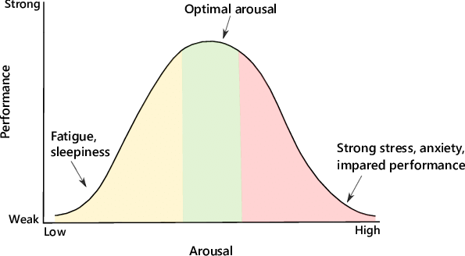
The Yerkes-Dodson Law - “U-shaped” curve

Slide 7
Anxiety vs. Fear…
Low Arousal
Having no stress at all isn’t necessarily a good thing in terms of performance
when your job is all about routine and nothing ever changes, boredom sets in
There’s no stress, but there’s also no motivation.
You’re not being challenged and have no incentive to go above and beyond.
Your work feels meaningless, so you do the bare minimum.

Slide 8
Anxiety vs. Fear…
Optimal arousal
A moderate level of stress goes a long way.
It’s manageable, motivational, and performance enhancing.
Your heart beats a bit faster.
You feel a sense of clarity and alertness.
Your brain and body are all fired up

Slide 9
Anxiety vs. Fear…
High arousal
Intense stress can lead to a fight, flight, or freeze response.
In these types of situations, stress and anxiety are ramping up to an unmanageable level.

Slide 10
Anxiety Disorders Include:
Specific phobia
Social anxiety disorder (SAD)
Panic disorder (PD)
Agoraphobia
Generalized anxiety disorder (GAD)
Anxiety Disorder due to a General Medical Condition
Substance-Induced Anxiety Disorder
Anxiety Disorder NOS

Slide 11
Anxiety Disorders
Most common psychiatric disorders
28% of psychiatric patients report anxiety symptoms
Most common are phobias

Slide 12
Criteria for Anxiety Disorders
DSM-5 criteria for each disorder:
  Symptoms interfere with important areas of functioning or cause marked distress
  Symptoms are not caused by a drug or a medical condition
  Symptoms persist for at least 6 months or at least 1 month for panic disorder
  The fears and anxieties are distinct from the symptoms of another anxiety disorder

Slide 13
When does anxiety become a disorder?
Anxiety becomes a disorder when out of proportion or when it significantly interferes with life.

Slide 14
The Anatomy of Anxiety
Amygdala- This is where emotions are given meaning, remembered, and attached to associations and responses to them (emotional memories).
The amygdala is considered to be part of the brain's limbic system (part of the brain involved in our behavioural and emotional responses).

Slide 15
The Anatomy of Anxiety…
Medial prefrontal cortex (includes the anterior cingulate cortex, the subcallosal cortex and the medial frontal gyrus)- involved in modulation of affect
Hippocampus- involved in memory encoding

Slide 16
Comorbid diagnoses
Once an anxiety disorder is diagnosed, it is critical to screen for other psychiatric diagnoses since it is very common for other diagnoses to be present and this can impact both treatment and prognosis.

Slide 17
Phobias
Disruptive fear of a particular object or situation
  Fear out of proportion to actual threat
  Awareness that fear is excessive
  Must be severe enough to cause distress or interfere with job or social life
    Avoidance

Slide 18
Specific phobia
Disproportionate fear of a particular object or situation
Common examples: fear of flying, snakes, heights, etc.
  Anxiety must be out of proportion to the actual danger or situation
  Awareness that fear is excessive
  It interferes significantly with the persons routine or function

Slide 19
DSM-5 Criteria for Specific Phobia
Marked and disproportionate fear consistently triggered by specific objects or situations
The object or situation is avoided or else endured with intense anxiety
Symptoms persist for at least 6 months

Slide 20
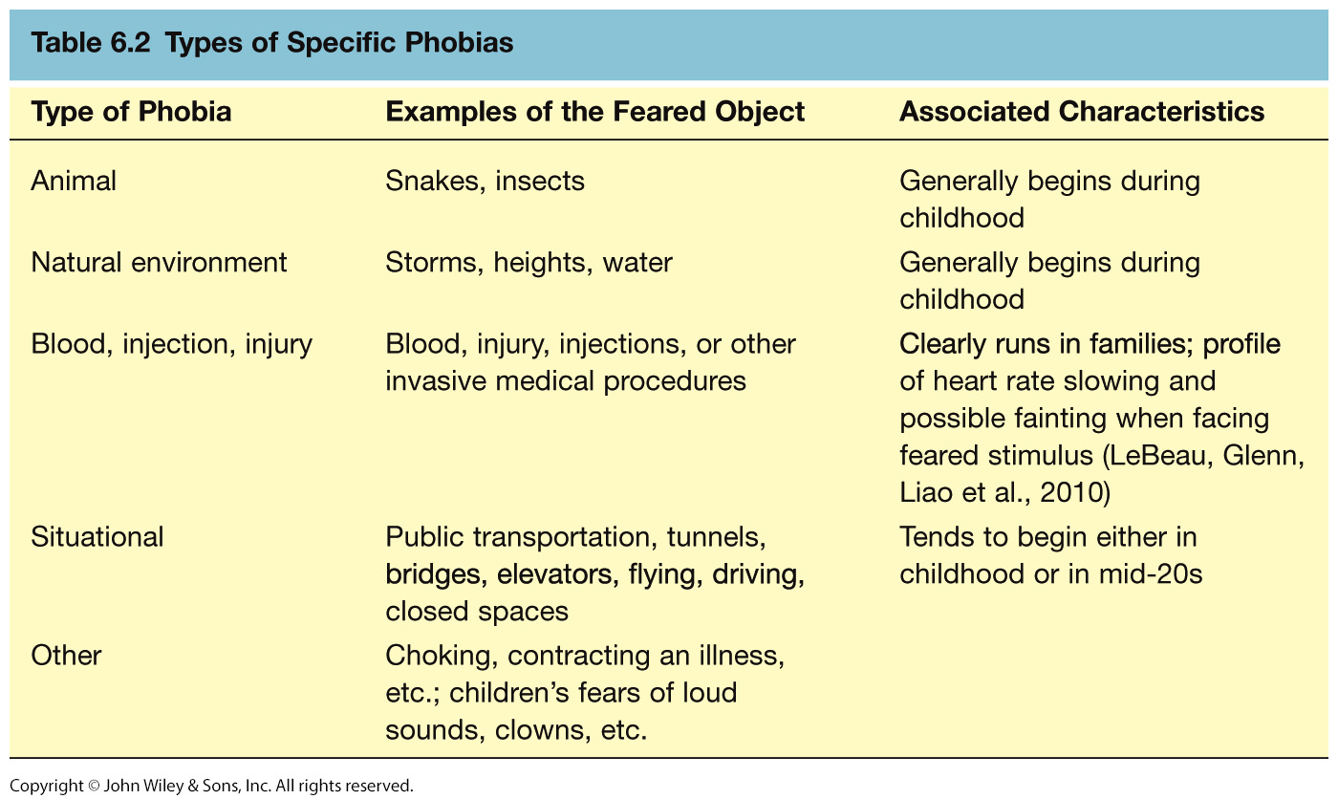
Types of Specific Phobias

Slide 21
Specific Phobia Cont’d…
Epidemiology
  Up to 15% of general population
  Onset early in life
  Female: Male 2:1
Etiology
  Learning, contextual conditioning
Treatment
  Systematic desensitization>>

Slide 22
Social Anxiety Disorder (SAD)
Previously called Social Phobia
  Causes more life disruption than other phobias
More intense and extensive than shyness
  Persistent, intense fear and avoidance of social situations
  Exposure to trigger leads to anxiety about being humiliated or embarrassed socially
  Trigger situations are avoided or else endured with intense anxiety

Slide 23
Social Anxiety Disorder (SAD) Cont’d…
Symptoms persist for at least 6 months
The avoidance, fear or distress significantly interferes with the person’s routine or function
  33% also diagnosed with Avoidant Personality Disorder

Slide 24
Epidemiology of SAD
7% of general population
Age of onset teens; more common in women.
Onset of symptoms: 13 and 23 years.
Causes significant disability
Increases depressive disorders

Slide 25
SAD treatment
Social skills training,
cognitive-behavioral therapy
Medication –
  SSRIs,
  SNRIs,
  MAOIs,
  benzodiazepines,
  gabapentin
>>

Slide 26
Panic Disorder
Recurrent unexpected panic attacks for a one month period manifested by:
  Persistent worry about having additional attacks
  Worry about the implications of the attacks
  Significant change in behavior because of the attacks

Slide 27
Panic Attack
A Panic Attack is: A discrete period of intense fear in which 4 of the following Symptoms abruptly develop and peak within 10 minutes:
Palpitations or rapid heart rate
Sweating
Trembling or shaking
Shortness of breath
Feeling of choking
Chest pain or discomfort
Nausea
Chills or heat sensations
Paresthesias
Feeling dizzy or faint
Derealization or depersonalization
Fear of losing control or going crazy
Fear of dying

Slide 28
Epidemiology of panic disorder
2-3% of general population;
5-10% of primary care patients ---Onset in teens or early 20’s
Female: male 2:1

Slide 29
Differentiating between the two
- A panic attack is not the same as panic disorder
Panic disorder often has a waxing and waning course
25% of people will experience a single panic attack (not the same as panic disorder)

Slide 30
Panic Disorder…
Un-cued panic attacks
  Occur unexpectedly without warning
  Panic disorder diagnosis requires recurrent un-cued attacks
  Causes worry about future attacks
Cued panic attacks
  Triggered by specific situations (e.g., seeing a snake)
    More likely a specific phobia

Slide 31
DSM-5 Criteria for Panic Disorder
Recurrent unexpected panic attacks
At least 1 month of concern about the
  possibility of more attacks,
  worry about the consequences of an attack, or
  maladaptive behavioral changes because of the attacks

Slide 32
Panic Disorder Comorbidity
50-60% have lifetime major depression (MDD)
  One third have current depression
20-25% have history of substance dependence

Slide 33
Panic Disorder - Treatment
Treated well, 70% of patients respond positively
Education, reassurance, elimination of caffeine, alcohol, drugs, OTC stimulants
Cognitive-behavioral therapy
Medications – SSRIs, venlafaxine, tricyclics, MAOIs, benzodiazepines, valproate, gabapentin >>

Slide 34
Agoraphobia
Marked fear or anxiety for more than 6 months about two or more of the following 5 situations:
  Using public transportation
  Being in open spaces
  Being in enclosed spaces (bridges, tunnels, etc.)
  Standing in line or being in a crowd
  Being outside of the home alone

Slide 35
Agoraphobia Cont’d…
The individual fears or avoids these situations because escape might be difficult or help might not be available
The agoraphobic situations almost always provoke anxiety
Anxiety is out of proportion to the actual threat posed by the situation
The agoraphobic situations are avoided or endured with intense anxiety
The avoidance, fear or anxiety significantly interferes with their routine or function

Slide 36
Agoraphobia: Prevalence
2% of the population
Females to males:2:1
Mean onset is 17 years
30% of persons with agoraphobia have panic attacks or panic disorder
Confers higher risk of other anxiety disorders, depressive and substance-use disorders>>

Slide 37
Generalized Anxiety Disorder (GAD)
Excessive worry more days than not for at least 6 months about a number of events and they find it difficult to control the worry.
Common worries:
  Relationships,
  health,
  finances,
  daily hassles
  Often begins in adolescence or earlier

Slide 38
Generalized Anxiety Disorder (GAD)…
3 or more of the following symptoms:
  Restlessness or feeling keyed up or on edge,
  easily fatigued,
  difficulty concentrating,
  Irritability,
  muscle tension,
  sleep disturbance
Causes significant distress or impairment

Slide 39
GAD - Epidemiology
4-7% of general population
Median onset = 30 years
Female: Male 2:1

Slide 40
GAD - Comorbidity
90% have at least one other lifetime Axis I Disorder (DSM IV)
66% have another current Axis I disorder

Slide 41
GAD Treatment
Medications including
  buspirone,
  benzodiazepines,
  antidepressants (SSRIs,
  venlafaxine,
  imipramine)
Cognitive-behavioral therapy
>>>*>>>

Slide 42
Obsessive-Compulsive and Related Disorders

Slide 43
Prevalence of Obsessive-Compulsive Related Disorders
Body Dysmorphic Disorder -2.4%
  9-15% of dermatologic pts
  7% of cosmetic surgery pts
  10% of pts presenting for oral or maxillofacial surgery!
Hoarding Disorder- est. 2-6% F<M
Trichotillomania 1-2% F:M 10:1!
Excoriation Disorder 1.4% F>M
Obsessive-Compulsive Disorder (OCD) – 2% in the general population

Slide 44
Body dysmorphic disorder
Body dysmorphic disorder is a mental health disorder in which you can't stop thinking about one or more perceived defects or flaws in your appearance — a flaw that appears minor or can't be seen by others.
But you may feel so embarrassed, ashamed and anxious that you may avoid many social situations.

Slide 45
Hoarding disorder
Hoarding disorder is a persistent difficulty discarding or parting with possessions because of a perceived need to save them.
A person with hoarding disorder experiences distress at the thought of getting rid of the items.
Excessive accumulation of items, regardless of actual value, occurs.

Slide 46
Trichotillomania
Trichotillomania also referred to as “hair-pulling disorder,” is a mental disorder classified under Obsessive-Compulsive and Related Disorders and involves recurrent, irresistible urges to pull hair from the scalp, eyebrows, eyelids, and other areas of the body

Slide 47
Excoriation disorder
Excoriation disorder is an obsessive-compulsive spectrum mental disorder that is characterized by the repeated urge or impulse to pick at one's own skin to the extent that either psychological or physical damage is caused.
Treatments: Habit reversal training

Slide 48
Obsessive-Compulsive Disorder (OCD)
Obsessions or compulsions or both defined by:
Obsessions defined by:
  recurrent and persistent thoughts, impulses or images that are intrusive and unwanted that cause marked anxiety or distress
  The person attempts to ignore or suppress such thoughts, urges or images, or to neutralize them with some other thought or action (i.e. compulsion)

Slide 49
OCD Cont’d…
Compulsions as defined by:
  Repetitive behaviors or mental acts that the person feels driven to perform in response to an obsession or according to rigidly applied rules.
  The behaviors or acts are aimed at reducing distress or preventing some dreaded situation however these acts or behaviors are not connected in a realistic way with what they are designed to neutralize or prevent.

Slide 50
OCD Cont’d…
The obsessions or compulsions cause marked distress;
  take > 1 hour/day or cause clinically significant distress or impairment in function

Slide 51
OCD Epidemiology
2% of general population
Mean onset 19 years, 25% start by age 14! Males have earlier onset than females
Female: Male 1:1

Slide 52
OCD Comorbidities
>70% have lifetime dx of an anxiety disorder such as PD, SAD, GAD, phobia
>60% have lifetime dx of a mood disorder MDD being the most common
Up to 30% have a lifetime Tic disorder
12% of persons with schizophrenia/ schizoaffective disorder

Slide 53
OCD Etiology
Genetics
Serotonergic dysfunction
Cortico-striato-thalamo-cortical loop
(circuit that controls movement execution, habit formation and reward)

Slide 54
Treatment
40-60% treatment response
Serotonergic antidepressants
Behavior therapy
Adjunctive antipsychotics,
psychosurgery
>>>

Slide 55
Trauma- and Stressor-Related Disorders

Slide 56
These Include:
Acute Stress Disorder
Adjustment Disorders
Posttraumatic Stress Disorder (PTSD)

Slide 57
Posttraumatic Stress Disorder - PTSD
Exposure to actual or threatened death, serious or sexual violence in one or more of the following ways:
  Direct experiencing of traumatic event(s)
  Witnessed in person the events as it occurred to others
  Learning that the traumatic event(s) occurred to person close to them
  Experiencing repeated or extreme exposure to aversive details of trauma

Slide 58
PTSD Cont’d…
Presence of 1 or more intrusive sx after the event
Persistent avoidance by 1 or both:
Recurrent, involuntary and intrusive memories of event
Recurrent trauma-related nightmares
Dissociative reactions
Intense physiologic distress at cue exposure
Marked physiological reactivity at cue exposure
Avoidance of distressing memories, thoughts or feelings of the event(s)
Avoidance of external reminders that arouse memories of event(s) e.g. people, places, activities

Slide 59
Negative alterations in cognitions and mood associated with the traumatic event(s) as evidenced by 2 or more of the following:
Inability to remember an important aspect of the traumatic event(s)
Persistent distorted cognitions about cause or consequence of event that lead to blame of self or others
Persistent negative emotional state
Marked diminished interest
Feeling detached from others
Persistent inability to experience positive emotions

Slide 60
Marked alterations in arousal and reactivity with 2 or more of:
Irritable behavior and angry outbursts
Reckless or self-destructive behavior
Hypervigilance
Exaggerated startle response
Problems with concentration
Sleep disturbance

Slide 61
Cont’d…
Duration of disturbance is more than one month AND causes significant impairment in function
Specifiers:
  With dissociative sx (derealization or depersonalization)
  With delayed expression (don’t meet criteria until >6 months after event)

Slide 62
PTSD Epidemiology
7-9% of general population
60-80% of trauma victims
30% of combat veterans
50-80% of sexual assault victims
Increased risk in women, younger people
Risk increases with “dose” of trauma, lack of social support, pre-existing psychiatric disorder

Slide 63
Comorbidities
Depression
Other anxiety disorders
Substance use disorders
Somatization
Dissociative disorders

Slide 64
PTSD Etiology
Conditioned fear
Genetic/familial vulnerability
Stress-induced release
  Norepinephrine, Chronic renal failure (CRF), Cortisol
Autonomic arousal immediately after trauma predicts PTSD

Slide 65
PTSD Treatment
Debriefing immediately following trauma is NOT necessarily effective
Cognitive-behavioral therapy, exposure
Group therapy
Medications – antidepressants, mood stabilizers, beta-blockers, clonidine, prazosin, gabapentin

Slide 66
Prazosin
Start at 1mg qid X 3 days
- then 2mg od x 3 nights
- Continue until nightmares improve
- or stop if the patient develops postural hypotension.
NB: Some patients can gain benefit at 1mg and some need >10mgs!
>>

Slide 67
Adjustment disorder
Adjustment disorder is a group of symptoms, such as stress, feeling sad or hopeless, and physical symptoms that can occur after you go through a stressful life event.
The symptoms occur because you are having a hard time coping.
Your reaction is stronger than expected for the type of event that occurred.

Slide 68
Acute Stress Disorder
Similar exposure as in PTSD
Acute stress disorder is an intense, unpleasant, and dysfunctional reaction beginning shortly after an overwhelming traumatic event and lasting less than a month.
If symptoms persist longer than a month, people are diagnosed as having posttraumatic stress disorder (PTSD).

Slide 69
Screening questions for ASD
Have you ever experienced a panic attack? (Panic)
Do you consider yourself a worrier? (GAD)
Have you ever had anything happen that still haunts you? (PTSD)
Do you get thoughts stuck in your head that really bother you or need to do things over and over like washing your hands, checking things or count? (OCD)
When you are in a situation where people can observe you do you feel nervous and worry that they will judge you? (SAD)

Slide 70
Treatment for ASD:
General treatment approaches
Pharmacotherapy
  Antidepressants
  Anxiolytics
  Antipsychotics
  Mood stabilizers
Psychotherapy- Cognitive Behavior Therapy (CBT)

Slide 71
serotonin
Cornerstone of treatment for anxiety disorders is increasing serotonin
Any of the SSRIs or SNRIs can be used

Slide 72
Drug Administration in Anxiety disorder

Slide 73
Drug Administration in Anxiety disorder
Start at ½ the usual dose used for antidepressant benefit i.e citalopram at 10mg rather than the usual 20mg
WARN THEM THEIR ANXIETY MAY GET WORSE BEFORE IT GETS BETTER!!
May need to use an anxiolytic while initiating and titrating the antidepressant

Slide 74
Other options
Hydroxyzine- usually 50mg prn. Helpful for some patients but has prominent anticholinergic Side Effects
Buspirone-For GAD- 60mg daily
Propranolol - Effective for discrete social phobia i.e. performance anxiety
Atypical antipsychotics at low doses for augmentation in difficult to treat OCD pts

Slide 75
Anticonvulsants
Valproic acid 500-750 mg bid (ending dose)
carbamazepine 200-600 mg bid (ending dose)
Gabapentin 900-2700 mg daily in 3 divided doses (ending dose)
Atypical antipsychotics at low doses for augmentation in difficult to treat OCD pts

Slide 76
Drugs Cont’d…
Benzodiazepines are very effective in reducing anxiety sx however due to the risk of dependence must use with caution
Depending on the patient may either use on a prn basis or scheduled
DO NOT USE ALPRAZOLAM- talk about a reinforcing drug!
For patients with a history of addiction or active drug/ETOH abuse or dependence benzodiazepines are not an option

Slide 77
Psychotherapy
Give or, Please refer to psychotherapist

Slide 78
Summary
Anxiety, Obsessive-Compulsive and Related, and Trauma and Stressor-related disorders are VERY common
There are significant comorbid psychiatric conditions associated with anxiety disorders!
Screening questions can help identify or rule out diagnoses
There are many effective treatments including psychotherapy and psychopharmacology
There is a huge amount of suffering associated with these disorders!
***

Slide 79
************************

Slide 80
Nursing Diagnoses – (PDs & Anxiety plus Related
Nursing Diagnoses | Analysis
Sensory perceptual alteration –disorientation about time, place, and person related to increased anxiety | Confusion or disorientation
Ineffective coping –obsessive thinking related to anxiety | Anxiety (Increased anxiety unapparent and discharge through obsessive thinking)
Impaired Social interactions –inability to form warm, meaningful relationships, related to compulsive behaviour | Lacks ability to develop warm relationship ( has limited ability to express emotion)
Ineffective coping –compulsion related to need for excessive cleanliness) | Excessive cleanliness (Over emphasis for cleanliness and neatness)
Potential for self harm related to poor impulse control associated with substance abuse) | Poor impulse control

Slide 81
Nursing Diagnoses – (PDs & Anxiety plus Related
Nursing Diagnoses | Analysis
Potential for self-harm related to marked disorientation , disorganization, and confusion | Disorientation, disorganization and confusion (If marked , patient is at high suicidal risk)
Distarbance of self-concept-insecurity related to suspiciousness | Insecurity, oversensitive, Failure to meet needs results in mistrust and insecurity
Potential for violence directed towards others related t perceived threat or injustice to himself | Anger and hostility –may become physically violent (Overly concerned with protecting himself from environment : overly sensitive)
Ineffective individual coping persecutory feeling related to mistrust | Feeling of being misjudged , conspired against, spied upon , followed , poisoned, dragged, obstructed in achieving long term goals.

Slide 82
THANKS FOR YOUR TIME

